Slide 1
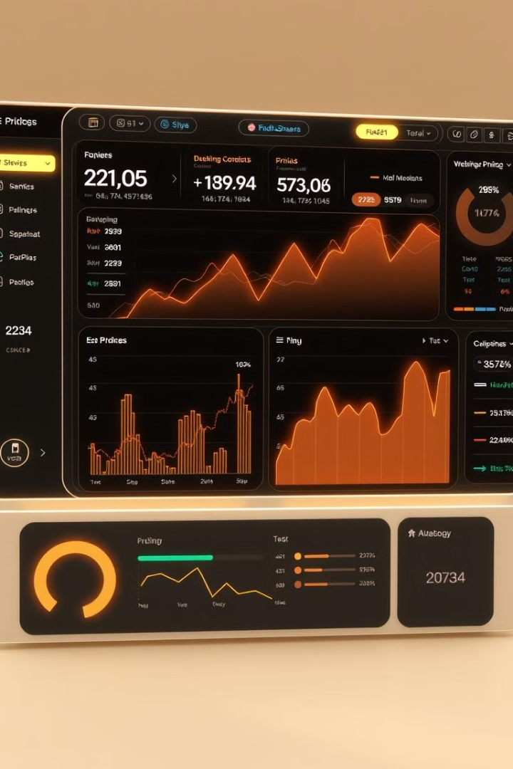
Dynamic Pricing Optimizer
AI-Powered Real-Time Pricing System

Slide 2
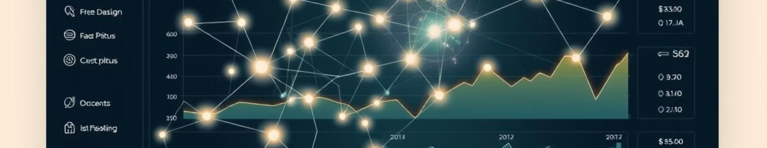
What is Dynamic Pricing Optimizer?
1
AI-Powered
2
Maximize Revenue
3
Uses Data
Real-time price adjustments.
Helps businesses stay competitive.
Market trends, competitor pricing, customer behavior.

Slide 3
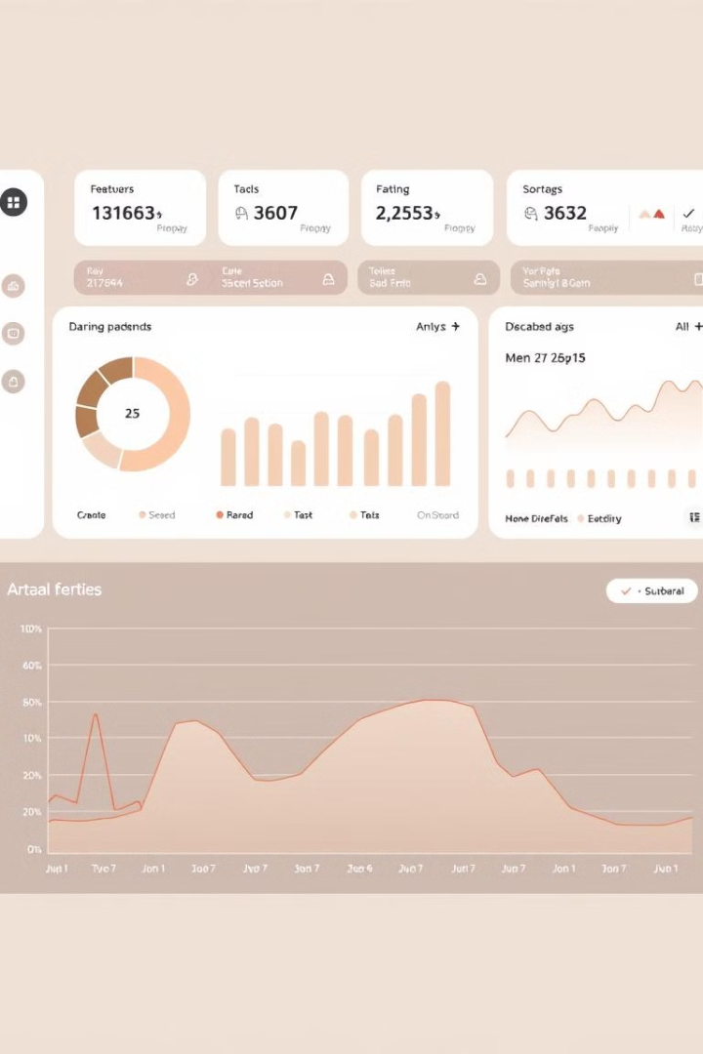




Key Features
Real-Time
Forecasting
Analysis
Price adjustments
Demand forecasting
Competitor analysis
Personalized
Personalized pricing

Slide 4
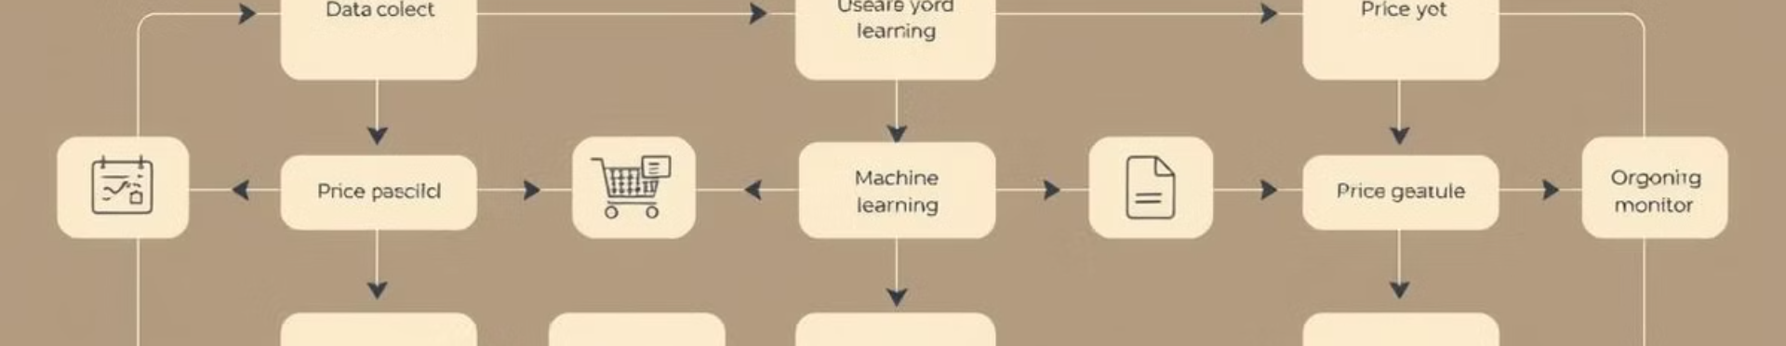




How It Works
Data Collection
ML Engine
Decision Module
Automation
Market, customer, business data
Predicts optimal prices
Implements pricing strategies
Updates prices dynamically

Slide 5
Implementation
Front-End
Back-End
AI/ML
APIs
HTML, CSS, JavaScript
Python, Flask
Random Forest, Gradient Boosting
Fetch pricing data, save settings

Slide 6
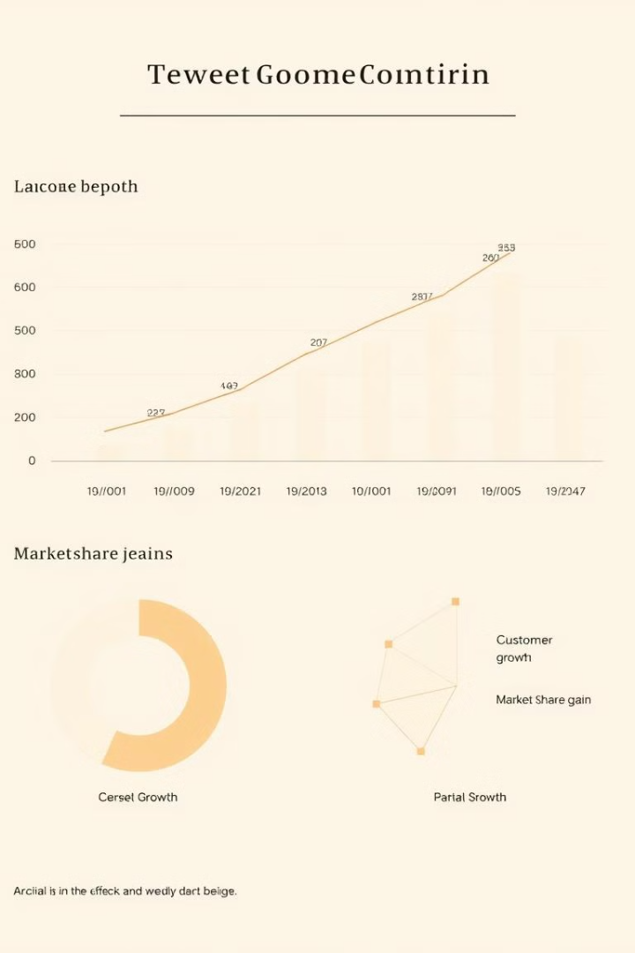
Results
15%
8%
Revenue Growth
Customer Retention
Increase in revenue
Improvement in retention
12%
Market Share
Gain in market share

Slide 7

Challenges
Data Accuracy
Customer Perception
Ensuring data quality
Managing customer views
Regulatory
Addressing constraints

Slide 8
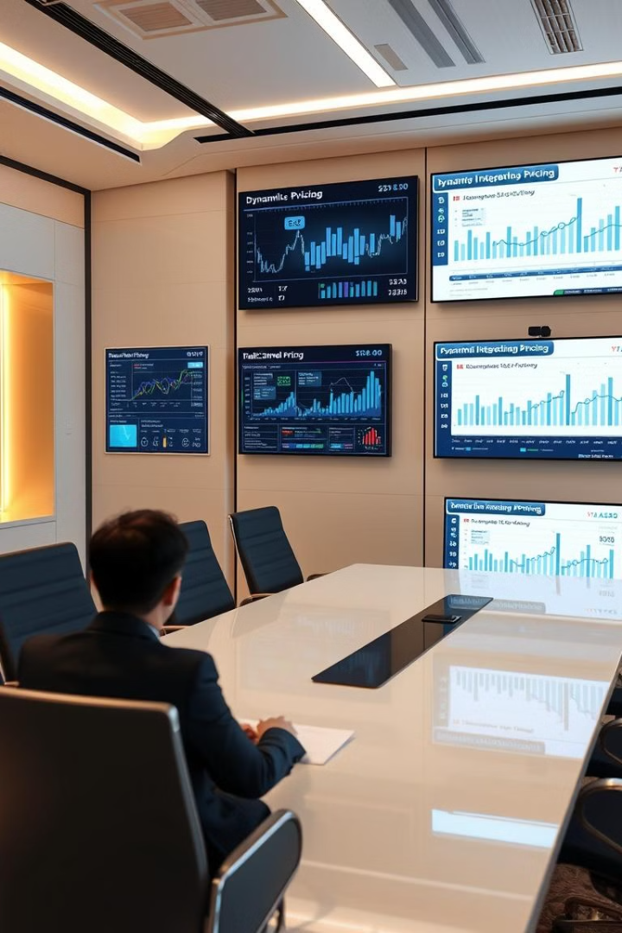
Future Scope
1
Blockchain
Integration with blockchain
2
AI Models
Enhanced AI models
3
Multi-Channel
Multi-channel pricing
4
Competitor Tracking
Real-time competitor tracking

